Slide 1

Discrete Mathematics
Unit 2
Sequence

Slide 2
What is a sequence?
What is the difference between finite and infinite?

Slide 3
Sequence:
A function whose domain is a set of consecutive integers (list of ordered numbers separated by commas).
Each number in the list is called a term.
For Example:
Sequence 1 Sequence 2
2,4,6,8,10 2,4,6,8,10,…
Term 1, 2, 3, 4, 5 Term 1, 2, 3, 4, 5
Domain – relative position of each term (1,2,3,4,5) Usually begins with position 1 unless otherwise stated.
Range – the actual “terms” of the sequence (2,4,6,8,10)

Slide 4
Sequence 1 Sequence 2
2,4,6,8,10 2,4,6,8,10,…
A sequence can be finite or infinite.
The sequence has a last term or final term.
(such as seq. 1)
The sequence continues without stopping.
(such as seq. 2)
Both sequences have an equation or general rule: a_{n} = 2n where n is the term # and a_{n} is the nth term.
The general rule can also be written in function notation: f(n) = 2n

Slide 5
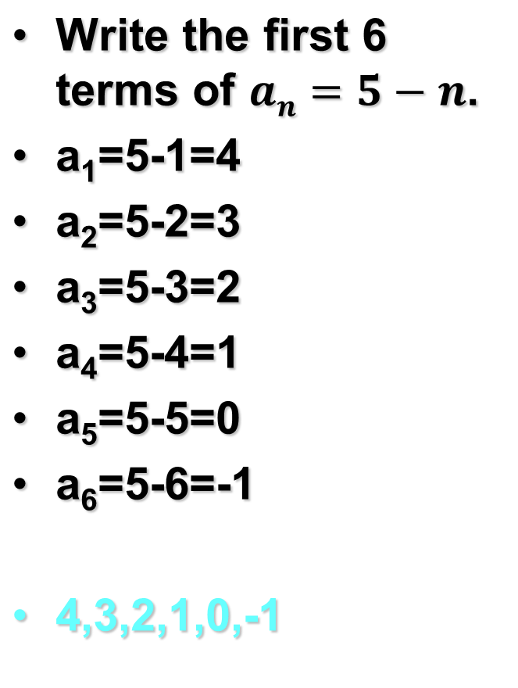
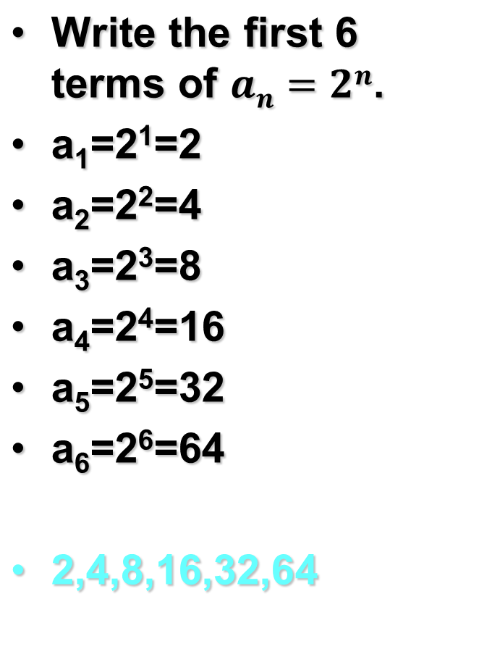
Examples:

Slide 6
Write the first six terms of f (n) = (– 3)^{n – 1}.
f (1) = (– 3)¹ ^{– 1} = 1
1st term
f (2) = (– 3)^{2 – 1} = – 3
2nd term
f (3) = (– 3)^{3 – 1} = 9
3rd term
f (4) = (– 3)^{4 – 1} = – 27
4th term
f (5) = (– 3)^{5 – 1} = 81
5th term
f (6) = (– 3)^{6 – 1} = – 243
6th term
You are just substituting numbers into the equation to get your term.

Slide 7
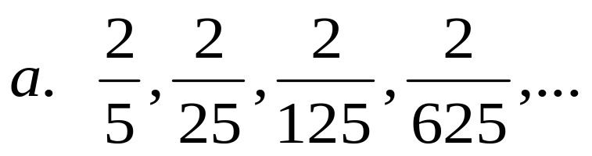
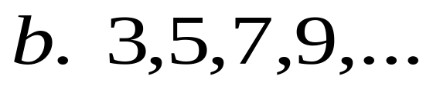
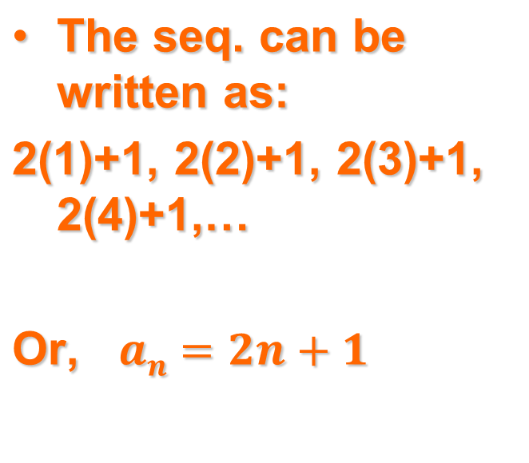
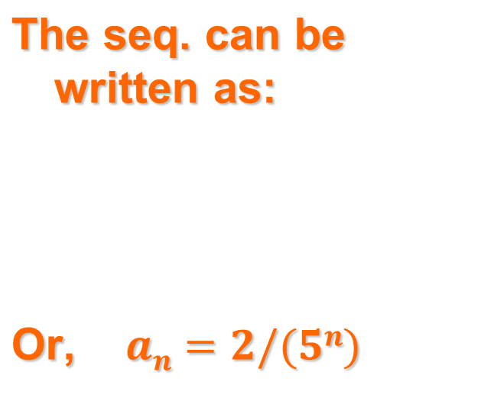
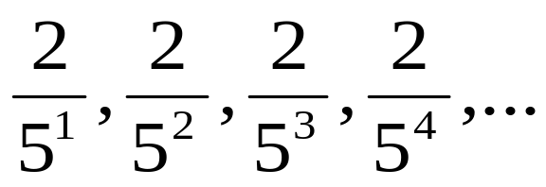
Examples: Write a rule for the nth term.
Look for a pattern…

Slide 8
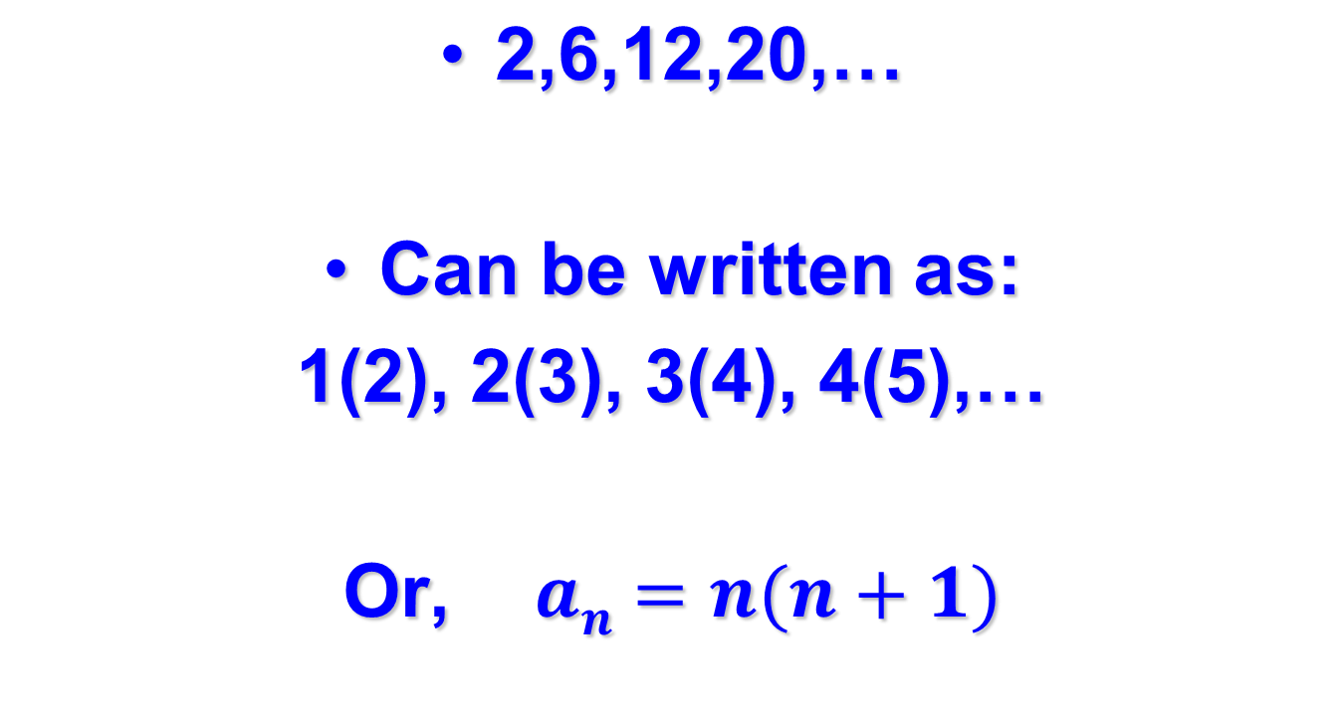
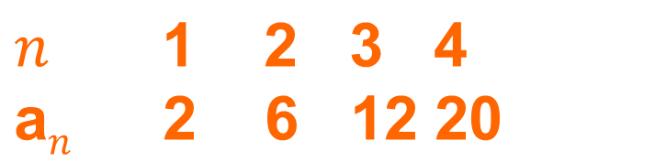
Example: write a rule for the nth term.
Think:

Slide 9
Describe the pattern, write the next term, and write a rule for the nth term of the sequence (a) – 1, – 8, – 27, – 64, . . .
SOLUTION
a). You can write the terms as (– 1)³, (– 2)³, (– 3)³,
(– 4)³, . . . . The next term is a₅ = (– 5)³ = – 125.
A rule for the nth term is a_{n} 5 (– n)³.

Slide 10
Describe the pattern, write the next term, and write a rule for the nth term of the sequence (b) 0, 2, 6, 12, . . . .
SOLUTION
b.
You can write the terms as 0(1), 1(2), 2(3), 3(4), . . . .
The next term is f (5) = 4(5) = 20. A rule for the nth term is f (n) = (n – 1)n.

Slide 11
Graphing a Sequence
Term #
Actual term
Think of a sequence as ordered pairs for graphing. (n , a_{n})
For example: 3,6,9,12,15
would be the ordered pairs (1,3), (2,6), (3,9), (4,12), (5,15) graphed like points in a scatter plot. DO NOT CONNECT ! ! !
* Sometimes it helps to find the rule first when you are not given every term in a finite sequence.

Slide 12
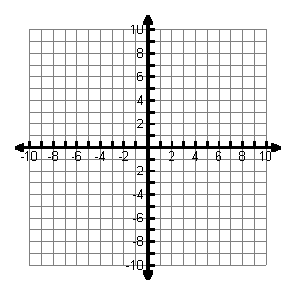
Graphing
n
1
2
3
4
a
3
6
9
12

Slide 13
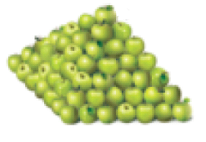
Retail Displays
You work in a grocery store and are stacking apples in the shape of a square pyramid with 7 layers. Write a rule for the number of apples in each layer. Then graph the sequence.
First Layer
SOLUTION
STEP 1
Make a table showing the number of fruit in the first three layers. Let a_{n} represent the number of apples in layer n.

Slide 14
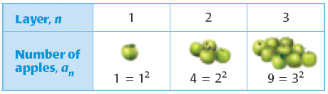
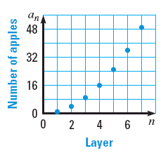
STEP 2
Write a rule for the number of apples in each layer. From the table, you can see that a_{n} = n².
STEP 3
Plot the points (1, 1), (2, 4),
(3, 9), . . . , (7, 49). The graph is shown at the right.

Slide 15

What is a sequence?
A collections of objects that is ordered so that there is a 1st, 2nd, 3rd,… member.
What is the difference between finite and infinite?
Finite means there is a last term. Infinite means the sequence continues without stopping.

Slide 16

Sequences and Series Day 2
What is a series?
How do you know the difference between a sequence and a series?
What is sigma notation?
How doummation notation?
Name 3 formulas for special series.

Slide 17
Series
The sum of the terms in a sequence.
Can be finite or infinite
For Example:
Finite Seq. Infinite Seq.
2,4,6,8,10 2,4,6,8,10,…
Finite Series Infinite Series
2+4+6+8+10 2+4+6+8+10+…

Slide 18
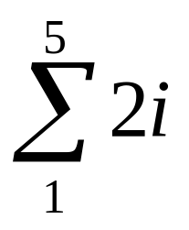
Summation Notation
Also called sigma notation
(sigma is a Greek letter Σ meaning “sum”)
The series 2+4+6+8+10 can be written as:
i is called the index of summation
(it’s just like the n used earlier).
Sometimes you will see an n or k here instead of i.
The notation is read:
“the sum from i=1 to 5 of 2i”
i goes from 1
to 5.

Slide 19
Summation Notation
Upper limit of summation
Lower limit of summation

Slide 20

Summation Notation for an
Infinite Series
Summation notation for the infinite series:
2+4+6+8+10+… would be written as:
Because the series is infinite, you must use i from 1 to infinity (∞) instead of stopping at the 5th term like before.

Slide 21
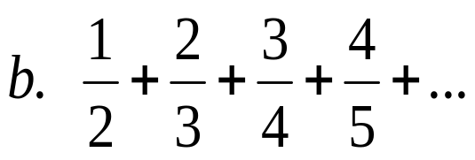
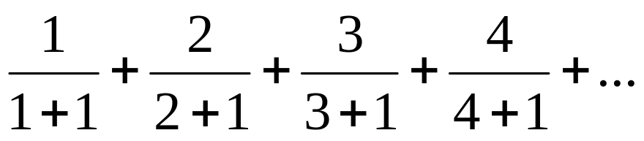
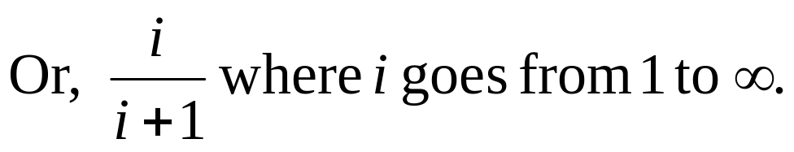
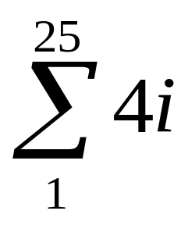
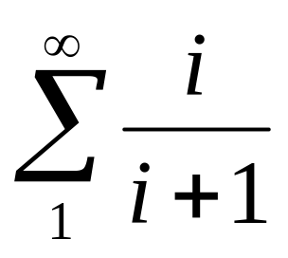
Examples: Write each series using summation notation.
a. 4+8+12+…+100
Notice the series can be written as:
4(1)+4(2)+4(3)+…+4(25)
Or 4(i) where i goes from 1 to 25.
Notice the series can be written as:

Slide 22
Write the series using summation notation.
a. 25 + 50 + 75 + . . . + 250
SOLUTION
a.
Notice that the first term is 25(1), the second is 25(2), the third is 25(3), and the last is 25(10). So, the terms of the series can be written as:
a_{i} = 25i where i = 1, 2, 3, . . . , 10
The lower limit of summation is 1 and the upper limit of summation is 10.
ANSWER
10
The summation notation for the series is
25i.
i = 1

Slide 23

Write the series using summation notation.
1
2
3
4
. . .
b.
+
+
+
2
3
4
5
SOLUTION
b.
Notice that for each term the denominator of the fraction is 1 more than the numerator. So, the terms of the series can be written as:
i
a_{i} =
where i = 1, 2, 3, 4, . . .
i + 1
The lower limit of summation is 1 and the upper limit of summation is infinity.
ANSWER
8
i
The summation notation for the series is
.
i + 1
i = 1

Slide 24
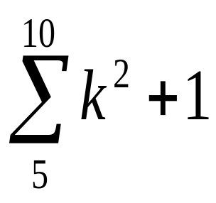
Example: Find the sum of the series.
k goes from 5 to 10.
(5²+1)+(6²+1)+(7²+1)+(8²+1)+(9²+1)+(10²+1)
= 26+37+50+65+82+101
= 361

Slide 25
Find the sum of the series.
8
(3 + k²) = (3 + 4²) 1 (3 + 5²) + (3 + 6²) + (3 + 7²) + (3 + 8²)
k – 4
= 19 + 28 + 39 + 52 + 67
= 205

Slide 26
Find the sum of series.
7
11.
(k² – 1)
k = 3
SOLUTION
We notice that the Lower limit is 3 and the upper limit is 7.
7
(k² – 1)
k = 3
= 9 – 1 + 16 – 1 + 25 – 1 + 36 – 1 + 49 – 1
= 8 + 15 + 24 + 35 + 48.
= 130 .
ANSWER
130.

Slide 27
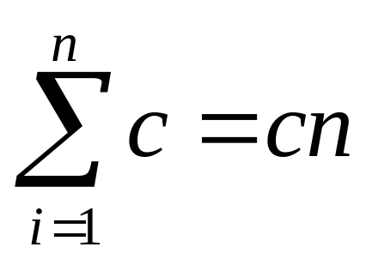
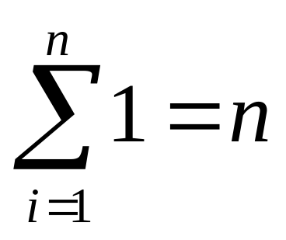
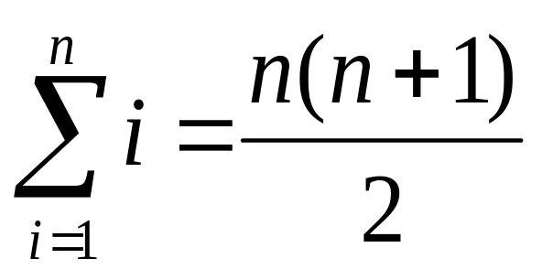
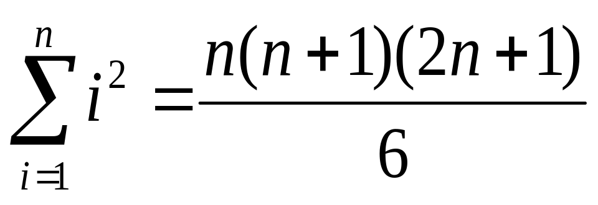
Special Formulas (shortcuts!)
Page 437

Slide 28
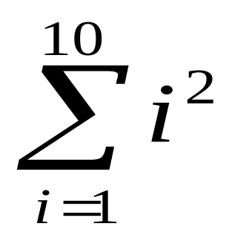
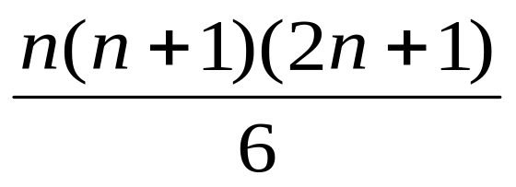
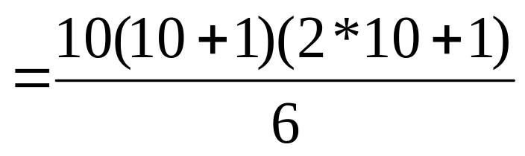
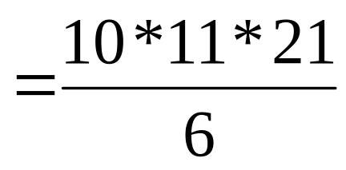
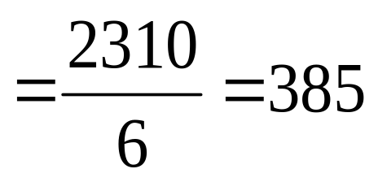
Example: Find the sum.
Use the 3rd shortcut!

Slide 29
Find the sum of series.
34
12.
1
i = 1
SOLUTION
We notice that the Lower limit is 1 and the upper limit is 34.
34
1
= 34.
i = 1
.
.
Sum of n terms of 1
ANSWER
.
34
1 = 34.
i = 1

Slide 30
Find the sum of series.
Sum of first n positive integers is.
6
13.
n
n (n + 1)
n
i
n = 1
=
i = 1
2
SOLUTION
6 (6 + 1)
=
We notice that the Lower limit is 1 and the upper limit is 6.
2
6 (7)
=
2
6
n
= 1 + 2 + 3 + 4 + 5 + 6
42
n = 1
= 21.
=
2
or
= 21
ANSWER
= 21

Slide 31
What is a series?
A series occurs when the terms of a sequence are added.
How do you know the difference between a sequence and a series?
The plus signs
What is sigma notation?
∑
How do you write a series with summation notation?
Use the sigma notation with the pattern rule.
Name 3 formulas for special series.

